Slide 1
HomeCookHub
Mary Meineke, Sarah Murdock, Preston Savey, John Thompson,

Slide 2
Names
Group Members:
Mary Meineke
meinekme@mail.uc.edu
Sarah Murdock
murdocsg@mail.uc.edu
Preston Savey
saveypc@mail.uc.edu
John Thompson
thomp5je@mail.uc.edu
Project Advisor:
Dr. Jillian Aurisano
jillian.aurisano@uc.edu

Slide 3
Goals
Project Goals:
Unified Platform: Create a one-stop solution for recipes, meal planning, and grocery list generation.
Community Interaction: Provide a space for users to share and learn from each other with a recipe review system.
Sustainable Cooking: Offer tips and features focused on eco-friendly cooking.
User Feedback: Continuously refine based on user input.
Increase Efficiency of Cooking: Synchronization of meal planning and grocery list to save time for our users.

Slide 4
Intellectual Merits (Sarah)
Community-Centric Approach: Enables users to share and discover recipes, promoting a collaborative cooking community.
Automated Meal Planning and Grocery List: Generates grocery lists from meal plans, automatically adjusting to the number of servings, which simplifies meal prep and minimizes food waste.
Real-Time Recipe Editing by Servings: Allows users to dynamically adjust recipes based on desired servings, ensuring ingredient quantities are always accurate.
Dietary Restriction Filters: Offers filters for various dietary needs, making it easier for users with specific health or dietary preferences to find suitable recipes.

Slide 5
Broader Impacts
Time Efficiency: One of the biggest challenges of home cooking is the time required for planning meals, shopping for ingredients, and the actual cooking process. HomeCookHub's features like automated grocery lists and meal planning help users organize their cooking schedules efficiently, saving time and making it more feasible for busy individuals and families to cook at home. Cost Savings: Cooking at home is generally more economical than eating out or ordering takeout. By facilitating home cooking, HomeCookHub can help users save money on food expenses. The meal planning feature further aids in budget management by preventing overbuying and reducing waste.
Cultural Exchange and Diversity: The platform can offer recipes from various cultures, promoting cultural exchange and appreciation among its users. This helps in fostering diversity and tolerance, as food is a universal language that brings people together, enhancing societal cohesion.

Slide 6
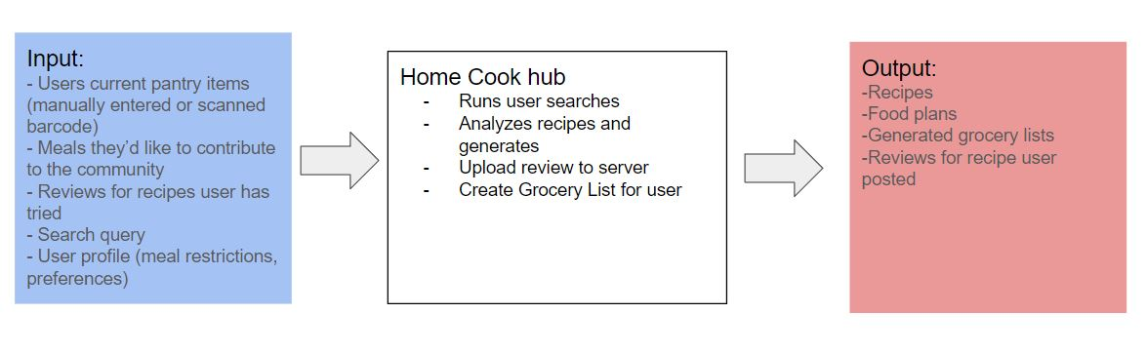
Design Diagram Level 1

Slide 7
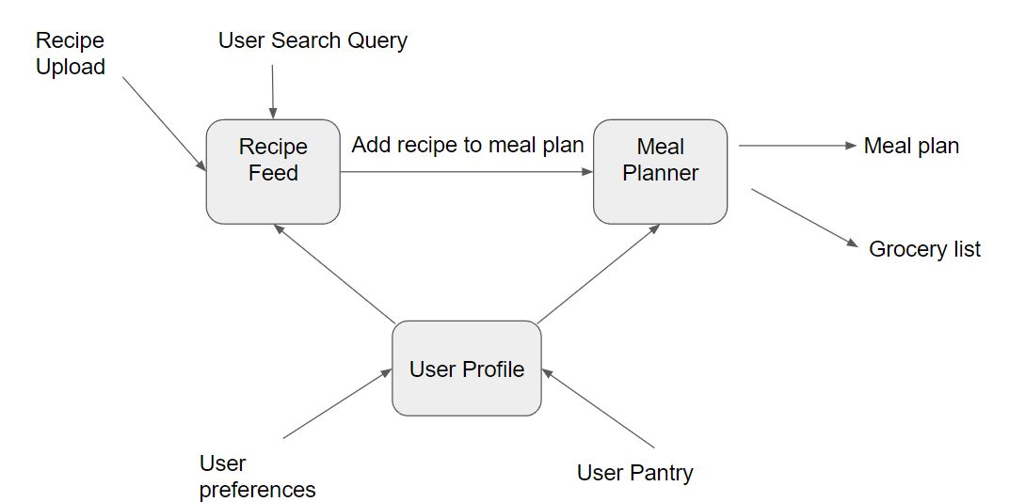
Design Diagram Level 2

Slide 8
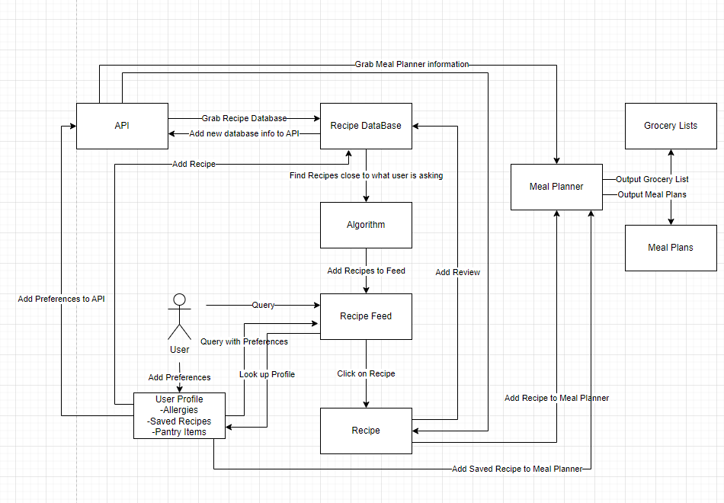
Design Diagram Level 3

Slide 9
Technologies
API — We developed a RESTful API for our project that allowed for communication between our application and the database holding the data. Developing this required putting thought into what information needs to be transferred and the most effective away of designing the routing. It required building from scratch.
Search — We also developed a search functionality that allowed users to easily find recipes they wanted based on the recipe title.
Notes:
API

Slide 10
Milestones
Grocery List UI (2/22/2024)
Finish Meal Planning Functionality (2/22/2024)
Grocery List and Meal Planning Sync (3/5/2024)
Refine the look of our app (3/19/2024)
Community/Tutorial Pages (3/20/2024)
API Creation (2/22/2024)
API Calls for Meal Planning and Grocery List (3/6/2024)
Basic Unit Testing (4/1/2024)
Integrate Login Page to Web (2/29/24)
Saved Recipes Sync (3/19/2024)

Slide 11
Results
We have a working demo of numerous features such as searching for recipes, clicking on the recipe to see recipe instructions, and seeing recipes that the user has planned
Established API and Web Server communication to access and update our firebase databases.
Tasks to Complete:
Meal Planning and Grocery List backend
UI Changes
Continue Development for our final deliverable

Slide 12
Challenges
API — Developing the API presented technical challenges as it required learning new skills in order to build it from scratch.
Collaboration — Figuring out the most effective way to split work between group members took some work to figure out. We needed to work out how to coordinate the different portions we were focused on so that they could come together into the whole application.
New Skills — All members of our group need to learn new skills and go beyond our comfort zone in order to bring this whole project together. This included learning new skills such as Firebase, React, authentication methods and more.

